Slide 1


Spatial Ecology and Macroecology, Winter 2024/2025
Lectures: Petr Keil, maybe Frieda Wölke
Practices: Flo Grattarola, Carmen Soria, Gabri Midolo, Frieda Wölke
Notes:
Hi, my name is Petr Keil and this is my project Biodiversity dynamics across a continuum of space, time, and their scales.

Slide 2
Course contents, conditions – 2024/2025
Oct 14 - no lecture (Petr at workshop), but yes practical class
Oct 28 – state holiday, no lecture and no practical class
Nov 11 – double lecture day (lecture instead of practical class)
Language: English & Czech
All materials: https://github.com/petrkeil/Spatial-Ecology-and-Macroecology
Zápočet:
Participation on practical classes (3 absences max)
Finishing and presenting a mini project during last 4 classes
Exam:
An informal 1:1 dialogue (ca 30 min)
Content of the lectures + content of the “Lectures” folder in the GitHub repo (.pdf papers) + questions related to practical classes
Notes:
These are also topics that we study in my research group.

Slide 3
Contacts and links
The teaching team for 2023/2024:
Petr Keil (guarantor, keil@fzp.czu.cz)
Flo Grattarola (postdoc, grattarola@fzp.czu.cz)
Carmen Soria (postdoc, soria_gonzalez@fzp.czu.cz)
Friederike Wölke (PhD student, wolke@fzp.czu.cz)
Gabriele Midolo (postdoc, gabriele.midolo@gmail.com)
Notes:
These are also topics that we study in my research group.

Slide 4


Petr Keil
I come from the outside
I have been doing macroecology for ~20 years, I still have limited idea about what is going on
MSc in zoology and ecology at BF JČU (České Budějovice)
2006-2010 - PhD in macroecology at PřF UK (Prof. David Storch)
2011-2014 - 3 years at Yale University, USA (Prof. Walter Jetz)
2015-2020 - 5 years at iDiv in Leipzig, Germany (Prof. Jonathan Chase)
At ČZU since fall 2020
Independently funded since January 2023
This course is tightly linked to our research
Stay tuned for jobs!
We are looking for master and bachelor students (supervised by me or our taff)
Notes:
These are also topics that we study in my research group.

Slide 5
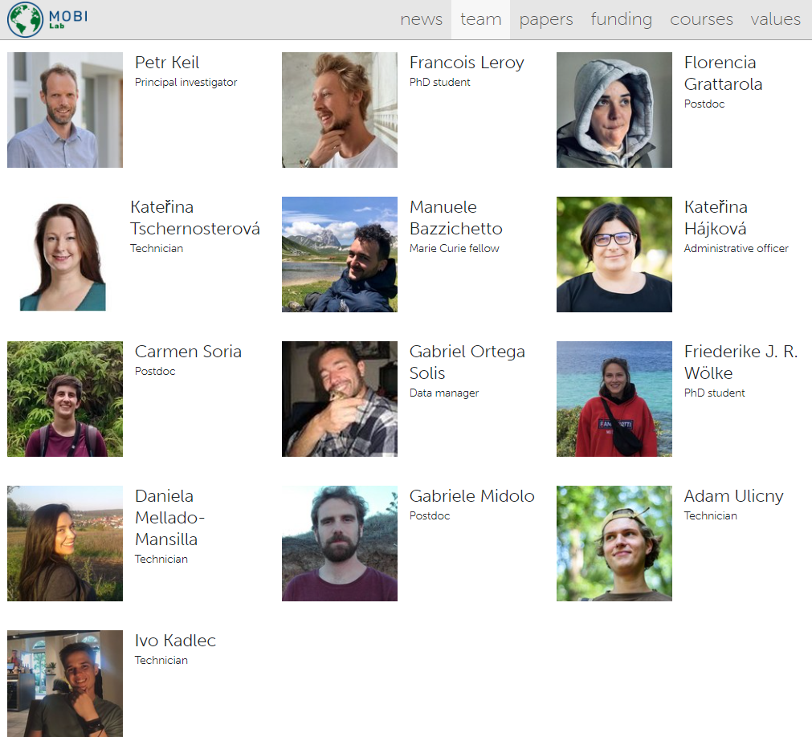
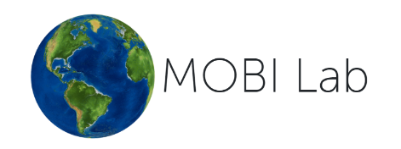

MOBI Lab (Modelling of Biodiversity Laboratory) - https://petrkeil.github.io/

Slide 6

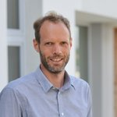

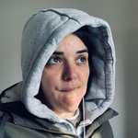
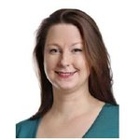

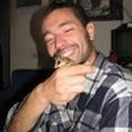

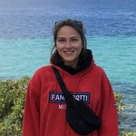

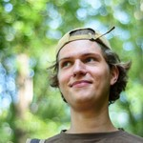

BEAST: Global biodiversity dynamics across spatial and temporal scales (ERC)
Petr Keil, Francois Leroy, Flo Grattarola, Kaca Tschernosterova, Carmen Soria, Gabriel Ortega, Frieda Wolke, Dani Mellado-Mansilla, Adam Ulicny, Ivo Kadlec

Slide 7
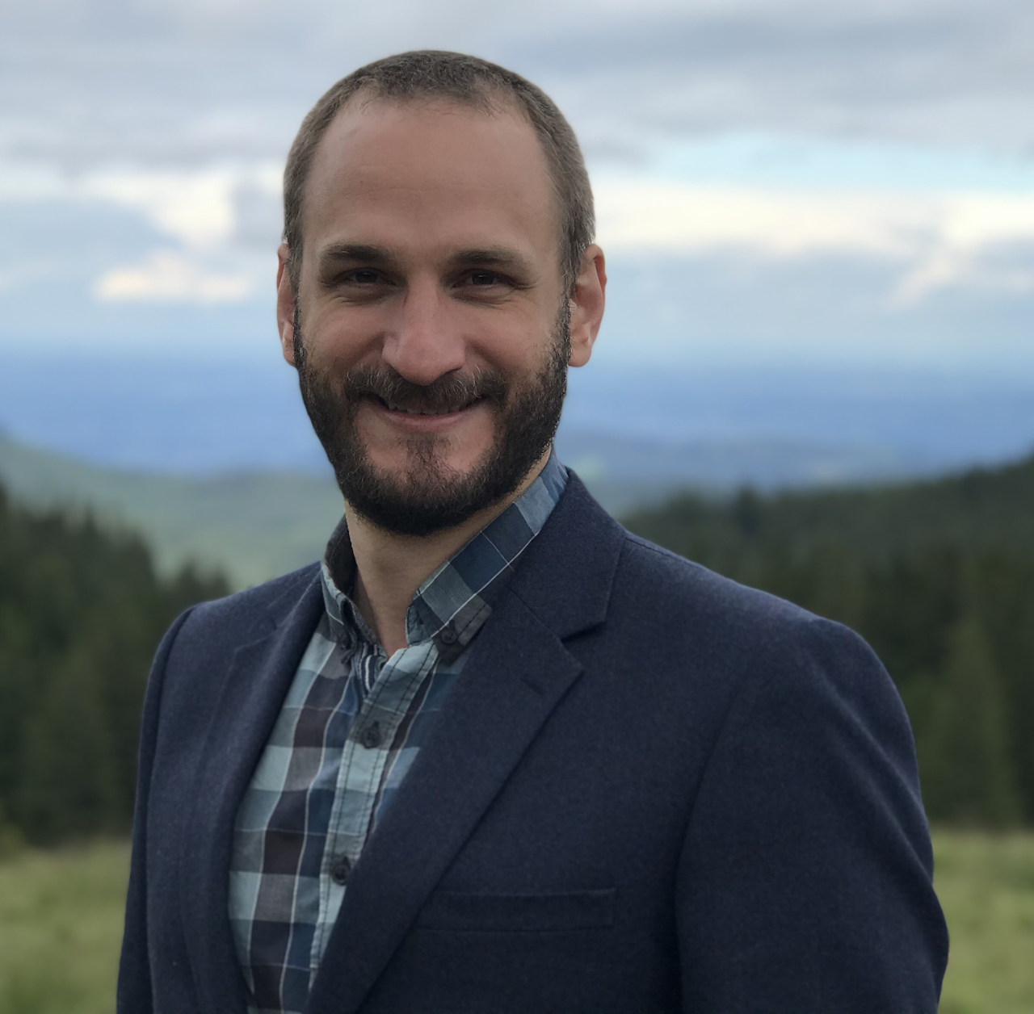
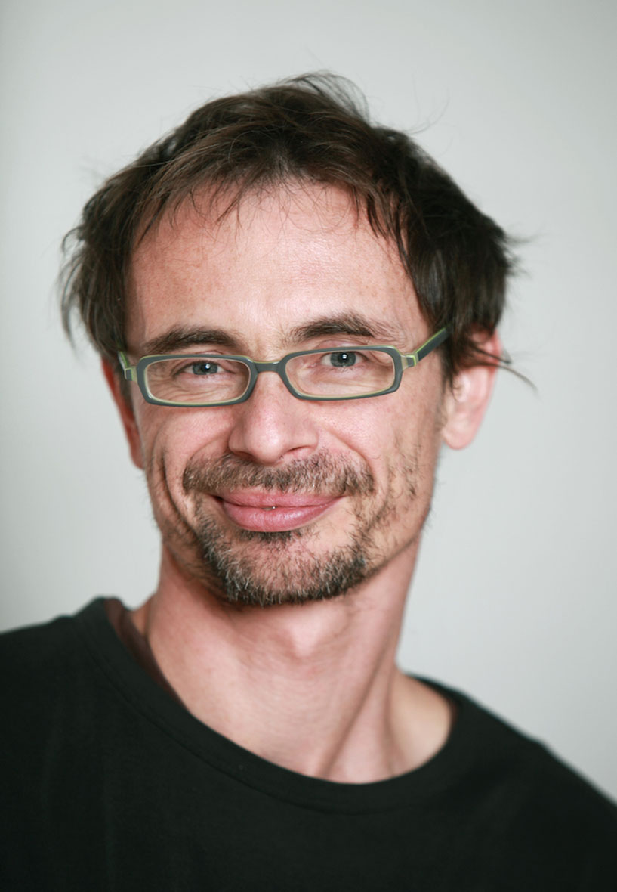

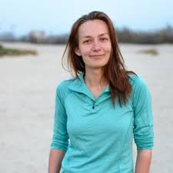
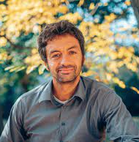


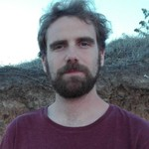
GRACE: 300 years of change in Austrian and Czech grasslands (GACR + FWF)
Petr Keil, Adam T. Clark, Hana Skokanova, Franz Essl, Stefan Dullinger, Gabriele Midolo, & team of field botanists

Slide 8
Spatial ecology and macroecology?

Slide 9
Do spatial ecology and macroecology even exist?
Spatial ecology
Macroecology
Geography
Biogeography
Biodiversity science
Ecosystem ecology
Conservation biology
Geostatistics, spatial modelling
Remote sensing
Evolutionary biology
Paleontology
Geographic Information Systems
Species Distribution Modelling
Spatial scale, grain, resolution, extent
Global, continental, regional, local
Notes:
These are also topics that we study in my research group.

Slide 10
Do spatial ecology and macroecology even exist?
Best literature:
No book that has it all; most literature in English, none in Czech as far as I know
Lomolino et al. – Biogeography
Ladle & Whittaker – Conservation Biogeograpy
Brown – Macroecology
Mittlebach & McGill – Community Ecology
Macdonald – Biodiversity Conservation
Begon – Základy ekologie (in Czech), i.e. chapter 10
Storch – Úvod do současné ekologie
Notes:
These are also topics that we study in my research group.

Slide 11

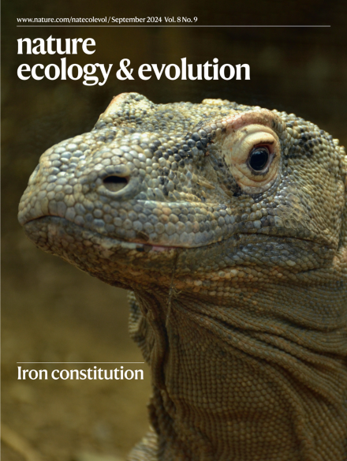





Societies, journals
Notes:
These are also topics that we study in my research group.

Slide 12
The currencies of macroecology and spatial ecology

Slide 13
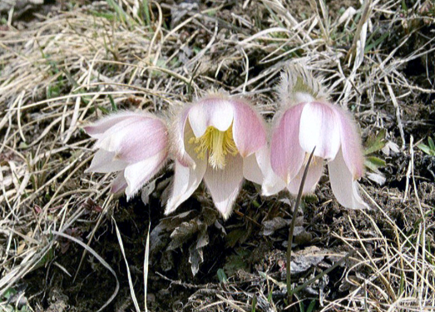
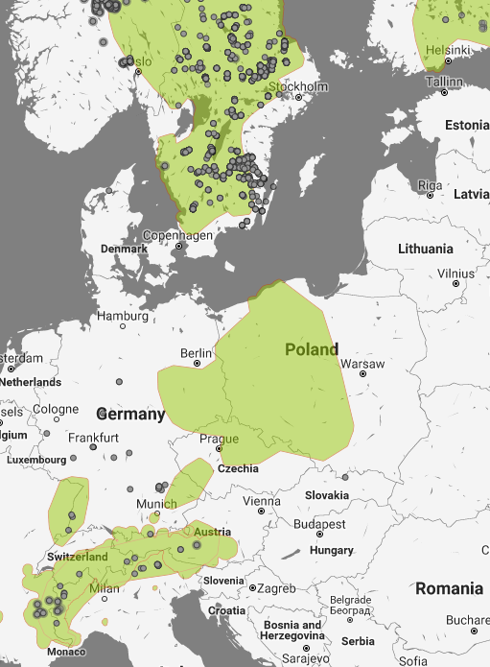
Species geographic distribution
Pulsatilla vernalis
Notes:
In this panel we can probably all agree that biodiversity is one of the most valuable natural resources.
But things like climate change or habitat loss are a threat to biodiversity, to the extent that we hear about biodiversity crisis, or sixth mass extinction
For example, about 1% of vertebrate species have gone extinct because of humans

Slide 14
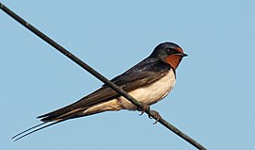
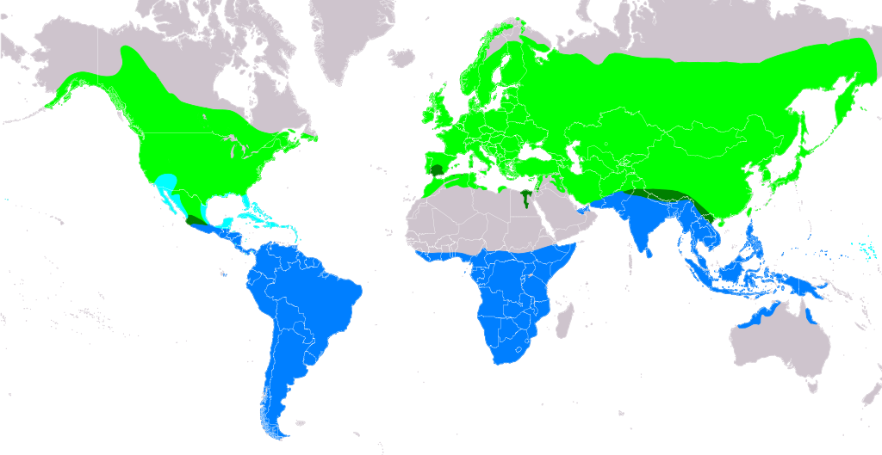
Species geographic range
Hirundo rustica
Source: https://en.m.wikipedia.org/wiki/File:Hirundo_rustica.png
Notes:
In this panel we can probably all agree that biodiversity is one of the most valuable natural resources.
But things like climate change or habitat loss are a threat to biodiversity, to the extent that we hear about biodiversity crisis, or sixth mass extinction
For example, about 1% of vertebrate species have gone extinct because of humans

Slide 15
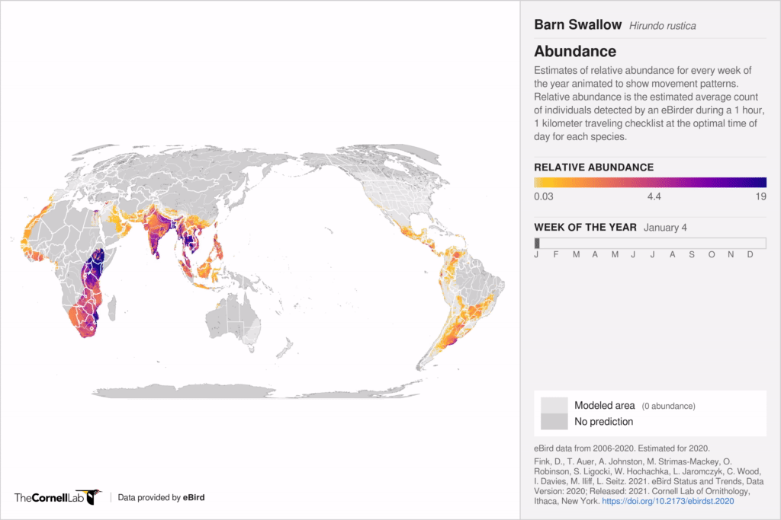
Species geographic range
Hirundo rustica
Source: eBird (https://science.ebird.org/en/status-and-trends/abundance-animations)
Notes:
In this panel we can probably all agree that biodiversity is one of the most valuable natural resources.
But things like climate change or habitat loss are a threat to biodiversity, to the extent that we hear about biodiversity crisis, or sixth mass extinction
For example, about 1% of vertebrate species have gone extinct because of humans

Slide 16
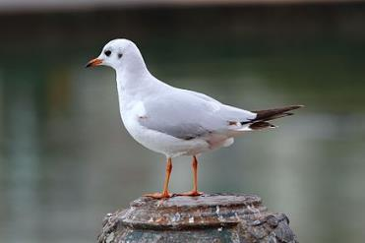
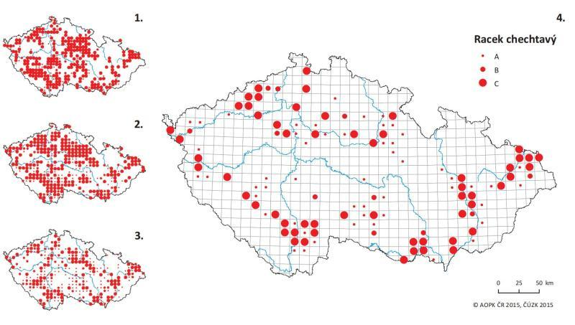
Species geographic distribution – occupancy or presence/absence
Chroicocephalus ridibundus
Bird atlases of the Czech Republic, Šťastný, Bejček, et al.
Notes:
In this panel we can probably all agree that biodiversity is one of the most valuable natural resources.
But things like climate change or habitat loss are a threat to biodiversity, to the extent that we hear about biodiversity crisis, or sixth mass extinction
For example, about 1% of vertebrate species have gone extinct because of humans

Slide 17
Species abundance, population density
Keil & Hines (2019) Nature Ecology & Evolution
Notes:
In this panel we can probably all agree that biodiversity is one of the most valuable natural resources.
But things like climate change or habitat loss are a threat to biodiversity, to the extent that we hear about biodiversity crisis, or sixth mass extinction
For example, about 1% of vertebrate species have gone extinct because of humans

Slide 18
Species composition
Keil & Hines (2019) Nature Ecology & Evolution
Notes:
In this panel we can probably all agree that biodiversity is one of the most valuable natural resources.
But things like climate change or habitat loss are a threat to biodiversity, to the extent that we hear about biodiversity crisis, or sixth mass extinction
For example, about 1% of vertebrate species have gone extinct because of humans

Slide 19
Commonness and rarity
Deborah Rabinowitz (1981) Seven forms of rarity
Notes:
In this panel we can probably all agree that biodiversity is one of the most valuable natural resources.
But things like climate change or habitat loss are a threat to biodiversity, to the extent that we hear about biodiversity crisis, or sixth mass extinction
For example, about 1% of vertebrate species have gone extinct because of humans

Slide 20
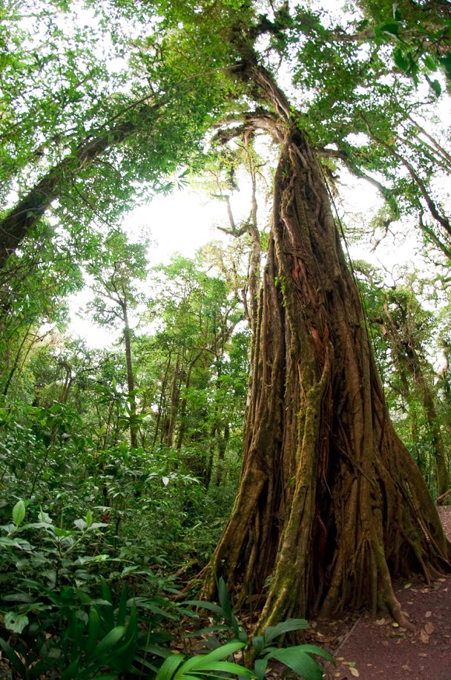
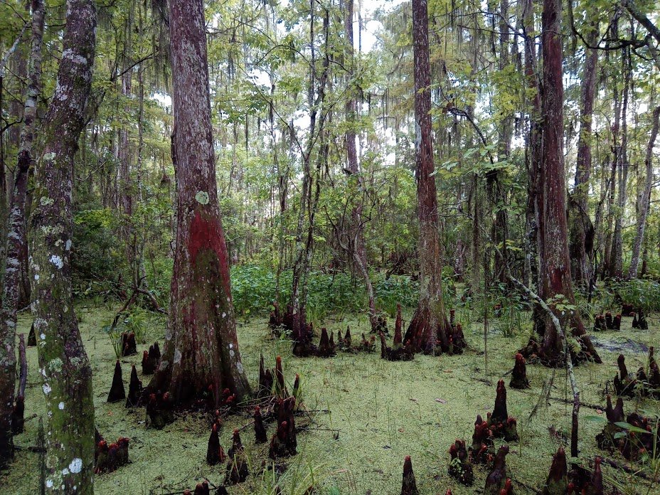
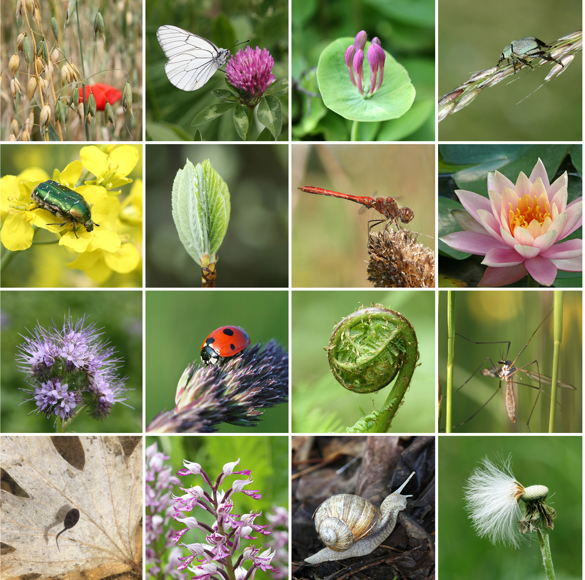
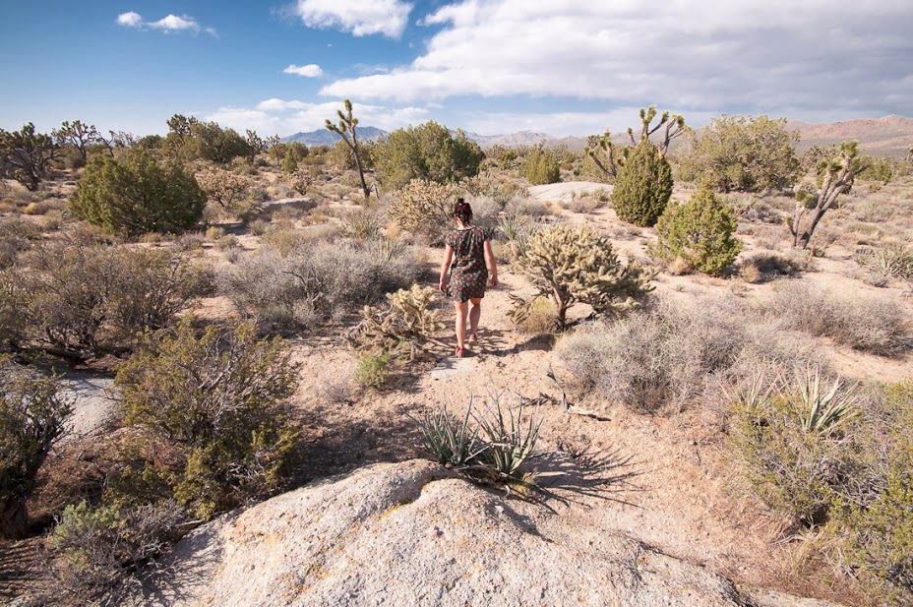
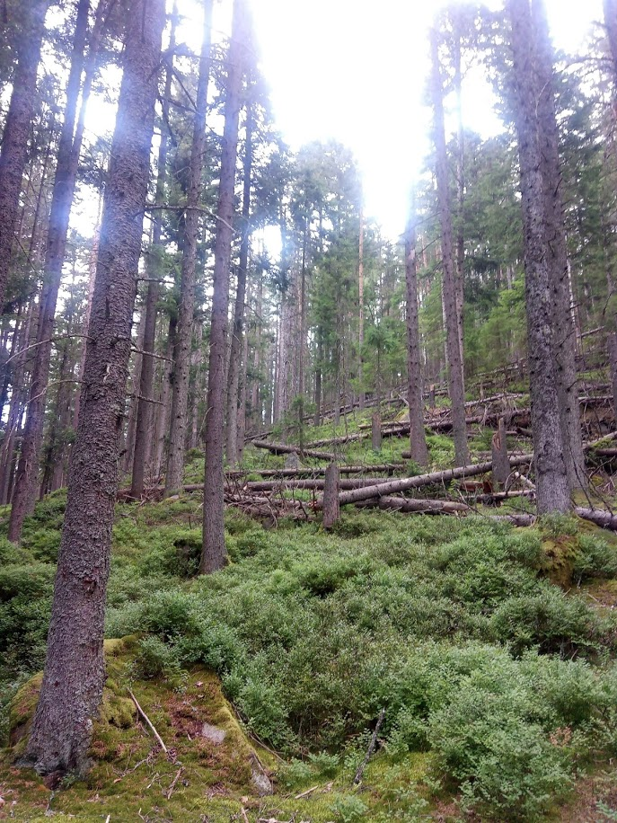
Biodiversity
Popular view: biodiversity = nature = ecosystem = anything that lives = quality

Slide 21
Biodiversity
Scientific view: biodiversity = measurable quantity
10 species of trees
1 tree species

Slide 22
Species richness = number of species
Keil & Hines (2019) Nature Ecology & Evolution
Notes:
In this panel we can probably all agree that biodiversity is one of the most valuable natural resources.
But things like climate change or habitat loss are a threat to biodiversity, to the extent that we hear about biodiversity crisis, or sixth mass extinction
For example, about 1% of vertebrate species have gone extinct because of humans

Slide 23
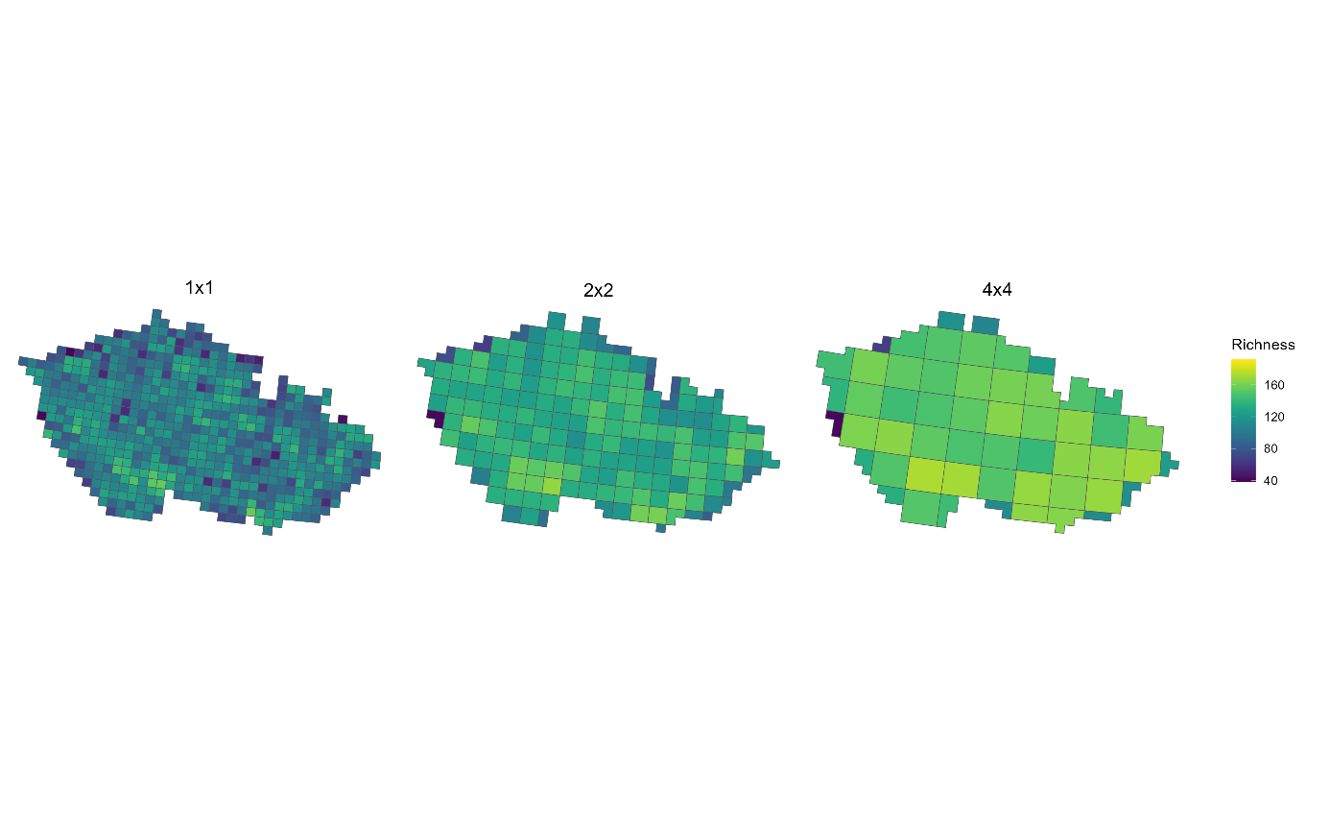
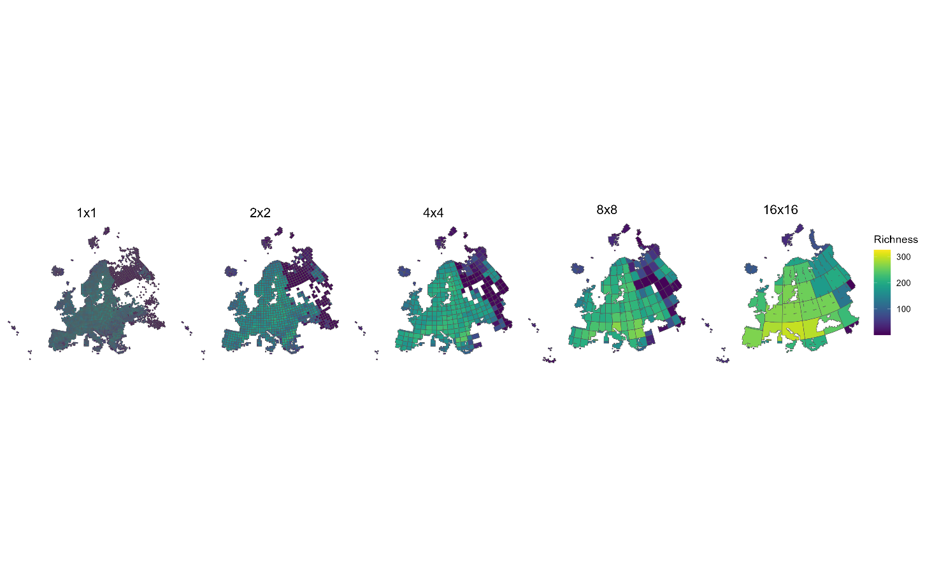
Species richness = number of species
Carmen Soria, unpublished analysis
Notes:
In this panel we can probably all agree that biodiversity is one of the most valuable natural resources.
But things like climate change or habitat loss are a threat to biodiversity, to the extent that we hear about biodiversity crisis, or sixth mass extinction
For example, about 1% of vertebrate species have gone extinct because of humans

Slide 24
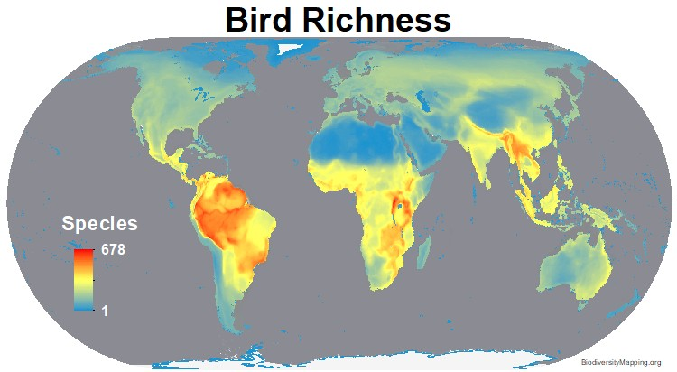
Species richness = number of species
BiodiversityMapping.org
Notes:
In this panel we can probably all agree that biodiversity is one of the most valuable natural resources.
But things like climate change or habitat loss are a threat to biodiversity, to the extent that we hear about biodiversity crisis, or sixth mass extinction
For example, about 1% of vertebrate species have gone extinct because of humans

Slide 25
Why should we care? Why does it matter?

Slide 26
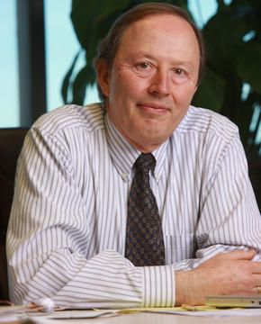
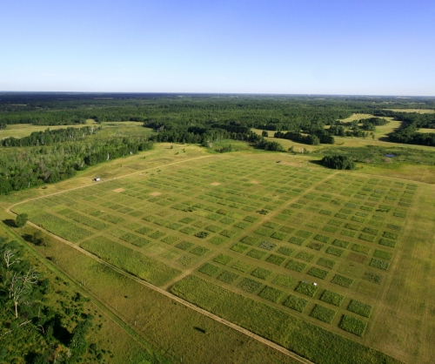
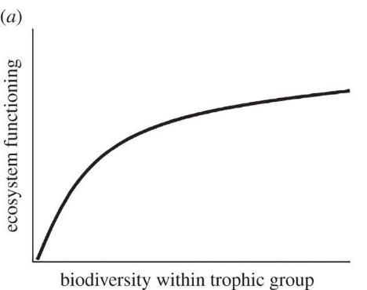
David Tilman – biodiversity and ecosystem functioning
More diverse communities are more productive and stable.
Tilman & Downing (1994) Nature
Notes:
In this panel we can probably all agree that biodiversity is one of the most valuable natural resources.
But things like climate change or habitat loss are a threat to biodiversity, to the extent that we hear about biodiversity crisis, or sixth mass extinction
For example, about 1% of vertebrate species have gone extinct because of humans

Slide 27
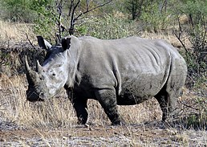
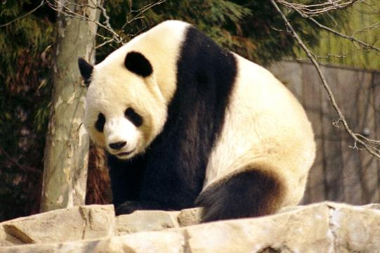
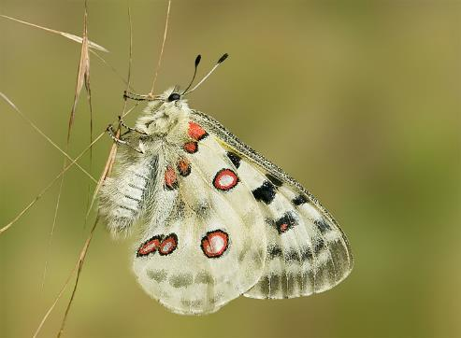
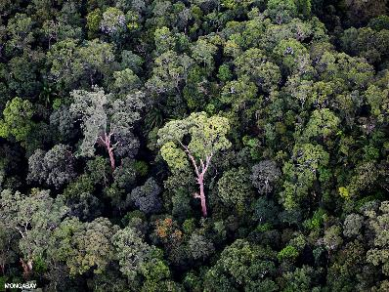
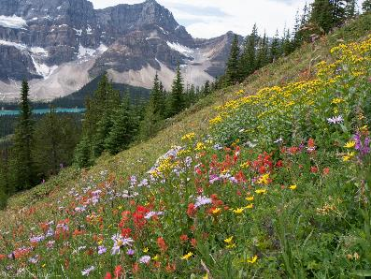
Culture, beauty, emotions, icons – nature’s contributions to people
Diaz et al. (2018) Science
Notes:
In this panel we can probably all agree that biodiversity is one of the most valuable natural resources.
But things like climate change or habitat loss are a threat to biodiversity, to the extent that we hear about biodiversity crisis, or sixth mass extinction
For example, about 1% of vertebrate species have gone extinct because of humans

Slide 28
Example big questions of macroecology

Slide 29
Some big questions (a random selection)
Why are some species rare and others common?
What are the most important threats to species?
Where are the most biologically rich/poor areas, and why?
How has been biodiversity changing in the Anthropocene?
What will the effect of climate change or habitat loss be on biodiversity?
How can we best protect species and biodiversity?
Why are the tropics so species rich?
What determines species composition?
Sutherland et al. (2012) Journal of Ecology
Notes:
In this panel we can probably all agree that biodiversity is one of the most valuable natural resources.
But things like climate change or habitat loss are a threat to biodiversity, to the extent that we hear about biodiversity crisis, or sixth mass extinction
For example, about 1% of vertebrate species have gone extinct because of humans

Slide 30
Brief history of macroecology and biogeography
The chronologically ordered list of old white males

Slide 31
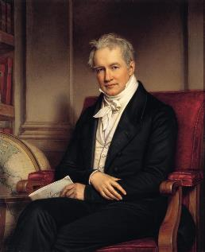
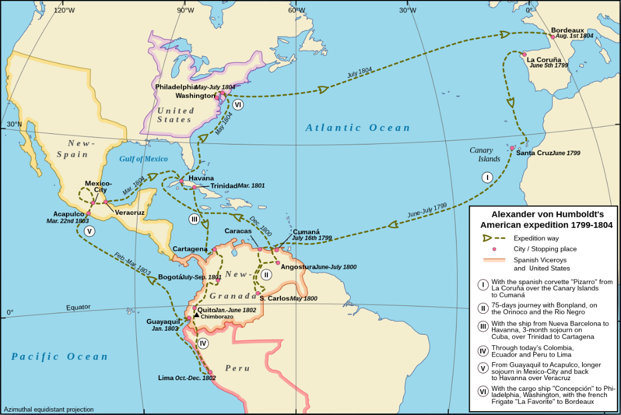
Alexander von Humboldt
1800
1850
1900
1950
2000
Notes:
In this panel we can probably all agree that biodiversity is one of the most valuable natural resources.
But things like climate change or habitat loss are a threat to biodiversity, to the extent that we hear about biodiversity crisis, or sixth mass extinction
For example, about 1% of vertebrate species have gone extinct because of humans

Slide 32
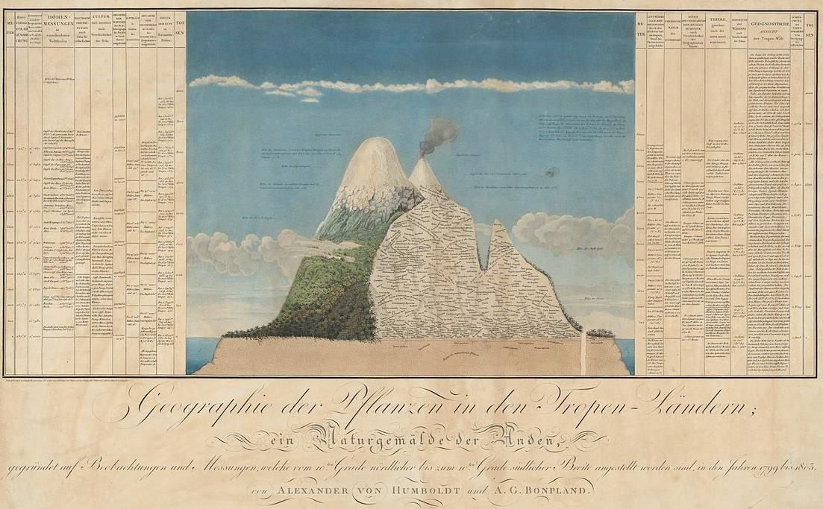
Alexander von Humboldt
1800
1850
1900
1950
2000
Naturgemälde, from The Geography of Plants, 1807
Notes:
In this panel we can probably all agree that biodiversity is one of the most valuable natural resources.
But things like climate change or habitat loss are a threat to biodiversity, to the extent that we hear about biodiversity crisis, or sixth mass extinction
For example, about 1% of vertebrate species have gone extinct because of humans

Slide 33
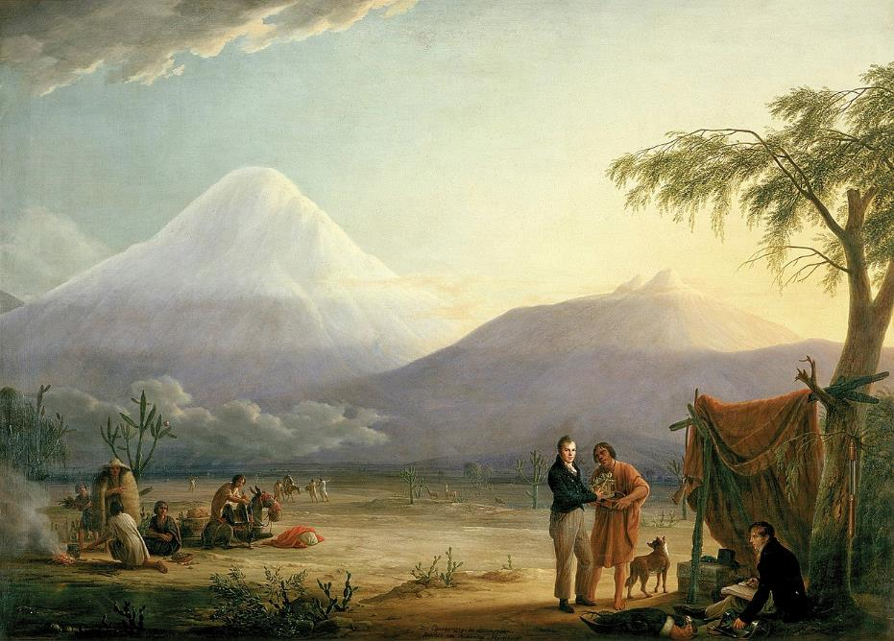
Alexander von Humboldt
1800
1850
1900
1950
2000
Chimborazo volcano, Friedrich Georg Weitsch (1810)
Notes:
In this panel we can probably all agree that biodiversity is one of the most valuable natural resources.
But things like climate change or habitat loss are a threat to biodiversity, to the extent that we hear about biodiversity crisis, or sixth mass extinction
For example, about 1% of vertebrate species have gone extinct because of humans

Slide 34
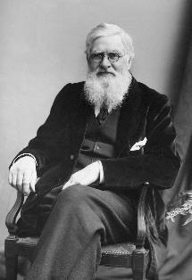
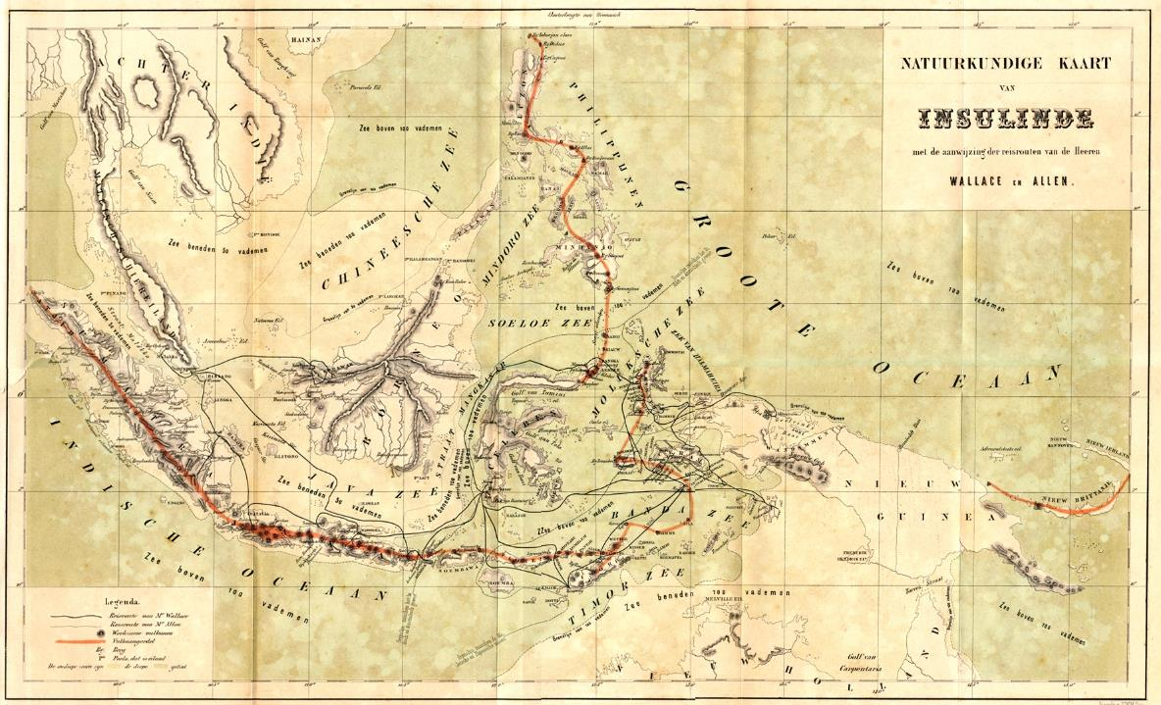
Alfred Russell Wallace – biogeographical regions
1800
1850
1900
1950
2000
Wallace (1876) The Geographical Distribution of Animals
Notes:
In this panel we can probably all agree that biodiversity is one of the most valuable natural resources.
But things like climate change or habitat loss are a threat to biodiversity, to the extent that we hear about biodiversity crisis, or sixth mass extinction
For example, about 1% of vertebrate species have gone extinct because of humans

Slide 35
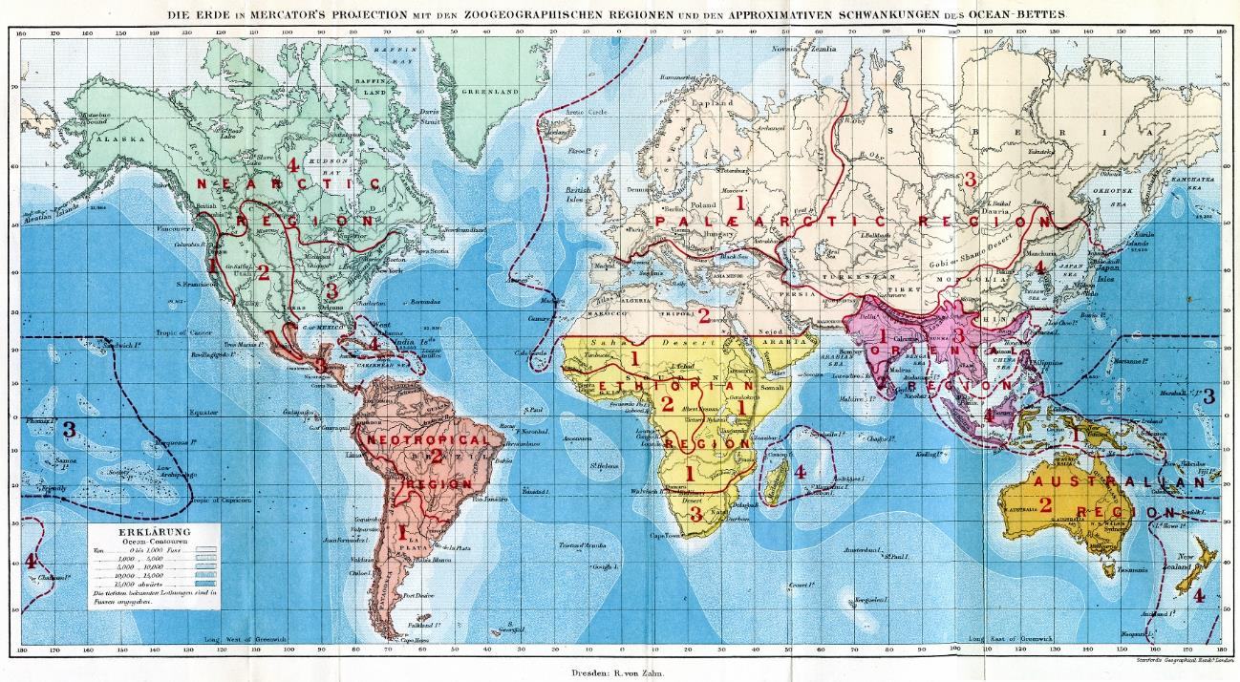
Alfred Russell Wallace – biogeographical regions
1800
1850
1900
1950
2000
Wallace (1876) The Geographical Distribution of Animals
Notes:
In this panel we can probably all agree that biodiversity is one of the most valuable natural resources.
But things like climate change or habitat loss are a threat to biodiversity, to the extent that we hear about biodiversity crisis, or sixth mass extinction
For example, about 1% of vertebrate species have gone extinct because of humans

Slide 36
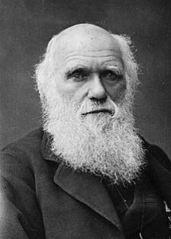
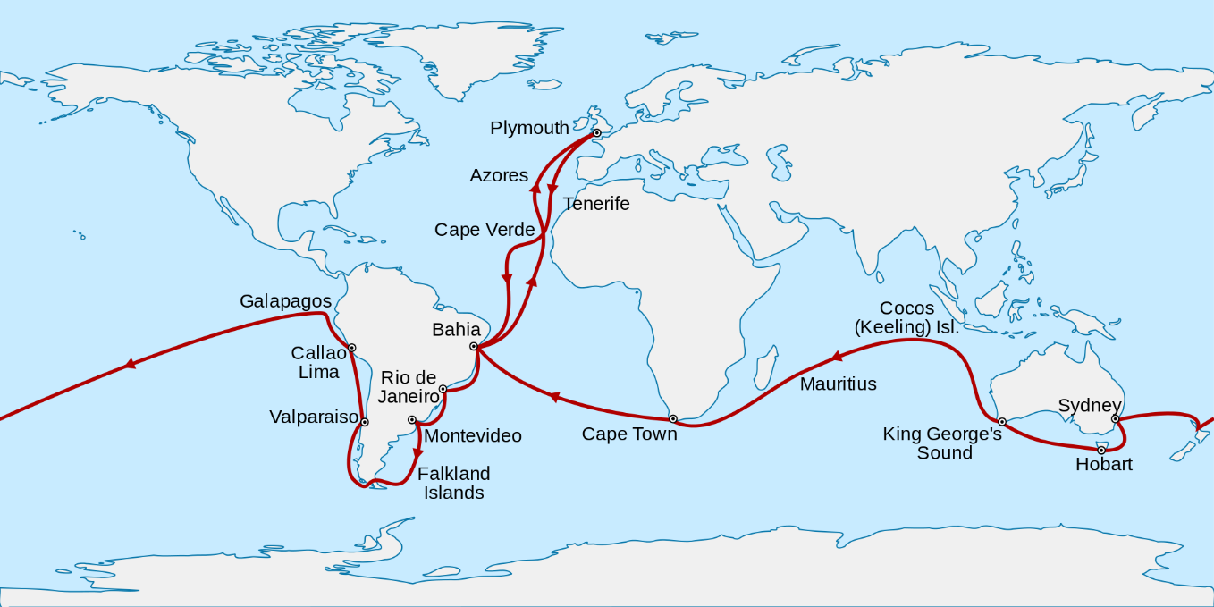
Charles Darwin – the idea of universal laws (the Entangled Bank)
1800
1850
1900
1950
2000
Darwin (1859) On the Origin of Species.
Voyage of the Beagle, 1831-1836
Notes:
In this panel we can probably all agree that biodiversity is one of the most valuable natural resources.
But things like climate change or habitat loss are a threat to biodiversity, to the extent that we hear about biodiversity crisis, or sixth mass extinction
For example, about 1% of vertebrate species have gone extinct because of humans

Slide 37
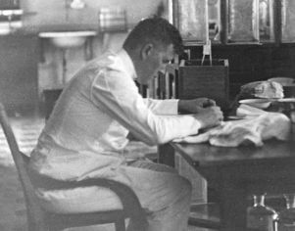
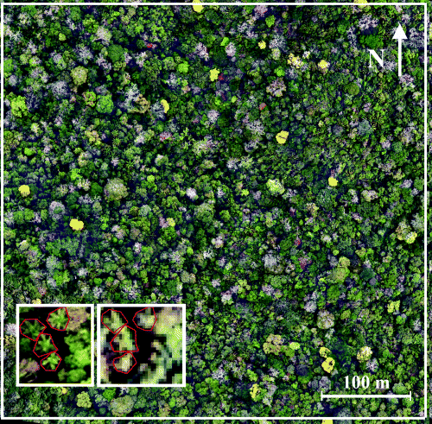
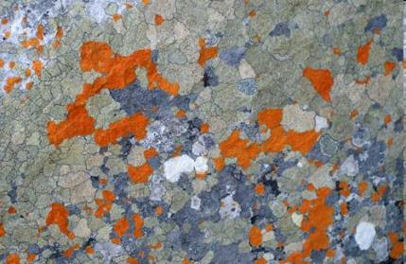
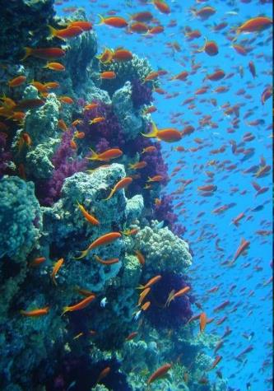
Olof Arrhenius –the larger the area the more species
1800
1850
1900
1950
2000
Arrhenius (1921) Species and area. Journal of Ecology, 9: 95-99.
Notes:
In this panel we can probably all agree that biodiversity is one of the most valuable natural resources.
But things like climate change or habitat loss are a threat to biodiversity, to the extent that we hear about biodiversity crisis, or sixth mass extinction
For example, about 1% of vertebrate species have gone extinct because of humans

Slide 38



Charles S. Elton – ecological niche
1800
1850
1900
1950
2000
Elton (1927) Animal Ecology
Notes:
In this panel we can probably all agree that biodiversity is one of the most valuable natural resources.
But things like climate change or habitat loss are a threat to biodiversity, to the extent that we hear about biodiversity crisis, or sixth mass extinction
For example, about 1% of vertebrate species have gone extinct because of humans

Slide 39


G. Evelyn Hutchinson – fundamental vs realized niche and the problem of rarity
1800
1850
1900
1950
2000
Hutchinson (1957) Concluding remarks, Cold Spring Harbor Quant Biol 22: 415-27.
Notes:
In this panel we can probably all agree that biodiversity is one of the most valuable natural resources.
But things like climate change or habitat loss are a threat to biodiversity, to the extent that we hear about biodiversity crisis, or sixth mass extinction
For example, about 1% of vertebrate species have gone extinct because of humans

Slide 40



Frank Preston – the distribution of rarity, triphasic species-area curve
1800
1850
1900
1950
2000
Site
Preston laboratories, Pennsylvania, where he did research on glass.
Storch (2016) JVS
Preston (1948) The Commonness, And Rarity, of Species. Ecology.
Notes:
In this panel we can probably all agree that biodiversity is one of the most valuable natural resources.
But things like climate change or habitat loss are a threat to biodiversity, to the extent that we hear about biodiversity crisis, or sixth mass extinction
For example, about 1% of vertebrate species have gone extinct because of humans

Slide 41


Robert MacArthur & Edward O. Wilson – theory of island biogeography
1800
1850
1900
1950
2000
Illustration: Corey J. A. Bradshaw
Macarthur & Wilson (1967) The Theory of Island Biogeography. Princeton.
Notes:
In this panel we can probably all agree that biodiversity is one of the most valuable natural resources.
But things like climate change or habitat loss are a threat to biodiversity, to the extent that we hear about biodiversity crisis, or sixth mass extinction
For example, about 1% of vertebrate species have gone extinct because of humans

Slide 42



James H. Brown, Michael Rosenzweig, John Lawton – macroecology and ecological patterns
1800
1850
1900
1950
2000
Is ecology a mess or are there universal laws an patterns, like in physics?
Brown (1995) Macroecology.
Rosenzweig (1995) Species diversity in space and time
Notes:
In this panel we can probably all agree that biodiversity is one of the most valuable natural resources.
But things like climate change or habitat loss are a threat to biodiversity, to the extent that we hear about biodiversity crisis, or sixth mass extinction
For example, about 1% of vertebrate species have gone extinct because of humans

Slide 43



Stephen P. Hubbell – neutral theory of biodiversity
1800
1850
1900
1950
2000
Hubbell (2001) The Unified Neutral Theory of Biodiversity and Biogeography. Princeton.
Notes:
In this panel we can probably all agree that biodiversity is one of the most valuable natural resources.
But things like climate change or habitat loss are a threat to biodiversity, to the extent that we hear about biodiversity crisis, or sixth mass extinction
For example, about 1% of vertebrate species have gone extinct because of humans

Slide 44



Brown, West, Gillooly, Enquist – metabolic theory of ecology
1800
1850
1900
1950
2000
Fractal networks
Metabolic scaling
Spatial patterns of biodiversity
Brown et al. (2004) Ecology.
Notes:
In this panel we can probably all agree that biodiversity is one of the most valuable natural resources.
But things like climate change or habitat loss are a threat to biodiversity, to the extent that we hear about biodiversity crisis, or sixth mass extinction
For example, about 1% of vertebrate species have gone extinct because of humans

Slide 45


John Harte – maximum entropy theory of ecology
1800
1850
1900
1950
2000
Notes:
In this panel we can probably all agree that biodiversity is one of the most valuable natural resources.
But things like climate change or habitat loss are a threat to biodiversity, to the extent that we hear about biodiversity crisis, or sixth mass extinction
For example, about 1% of vertebrate species have gone extinct because of humans

Slide 46


Rosemary Gillespie, Helene Morlon – evolutionary mechanisms, adaptive radiations
1800
1850
1900
1950
2000
Notes:
In this panel we can probably all agree that biodiversity is one of the most valuable natural resources.
But things like climate change or habitat loss are a threat to biodiversity, to the extent that we hear about biodiversity crisis, or sixth mass extinction
For example, about 1% of vertebrate species have gone extinct because of humans

Slide 47


Virginia Norwood – designed first multispectral scanner, LANDSAT
1800
1850
1900
1950
2000
Notes:
In this panel we can probably all agree that biodiversity is one of the most valuable natural resources.
But things like climate change or habitat loss are a threat to biodiversity, to the extent that we hear about biodiversity crisis, or sixth mass extinction
For example, about 1% of vertebrate species have gone extinct because of humans

Slide 48


Summary
1800
1850
1900
1950
2000
The age of exploration
Humboldt, Wallace, Darwin
Description of universal
laws and patterns
Arrhenius, Preston, Lawton
The age of theories
Hubbell, Brown, Harte
Log Species diversity
Niche theory
Neutral theory
Metabolic theory
Maximum entropy theory
Log Area
Species-area relationship
Latitudinal gradient of richness
Distance decay of similarity of communities
Species-abundance distributions
Notes:
In this panel we can probably all agree that biodiversity is one of the most valuable natural resources.
But things like climate change or habitat loss are a threat to biodiversity, to the extent that we hear about biodiversity crisis, or sixth mass extinction
For example, about 1% of vertebrate species have gone extinct because of humans

Slide 49
Thank you. Questions?

